Slide 1
Android
Lab 02
2017-2018

Slide 2
Agenda
Temperature Converter Application
Radio Buttons
Toast
Spinners
Deploying Android Application to Mobile.

Slide 3
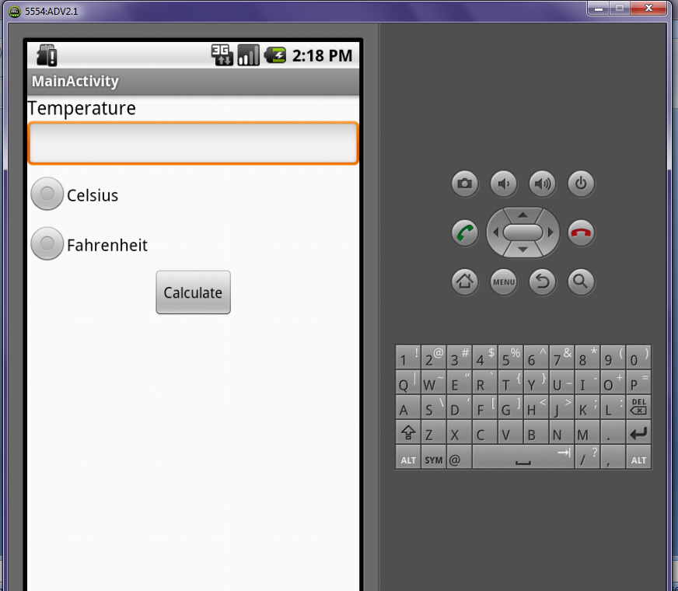
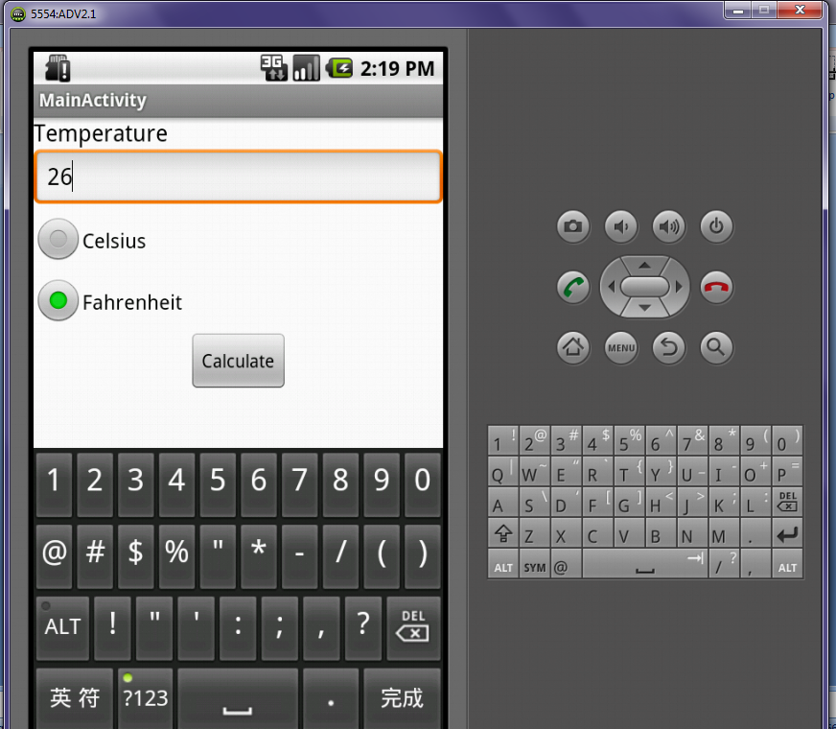

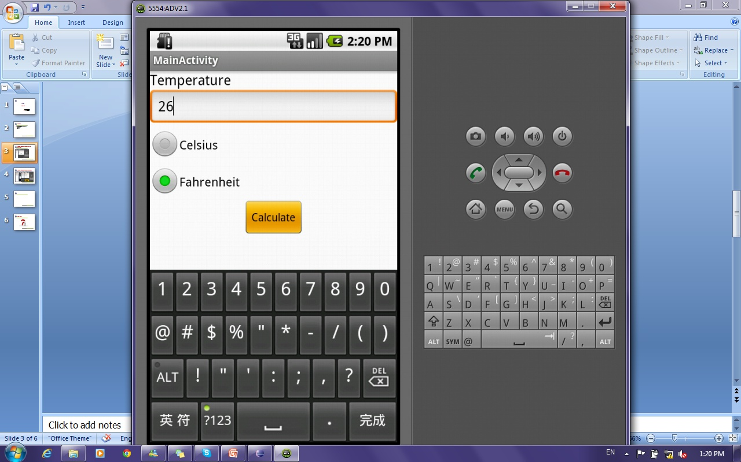
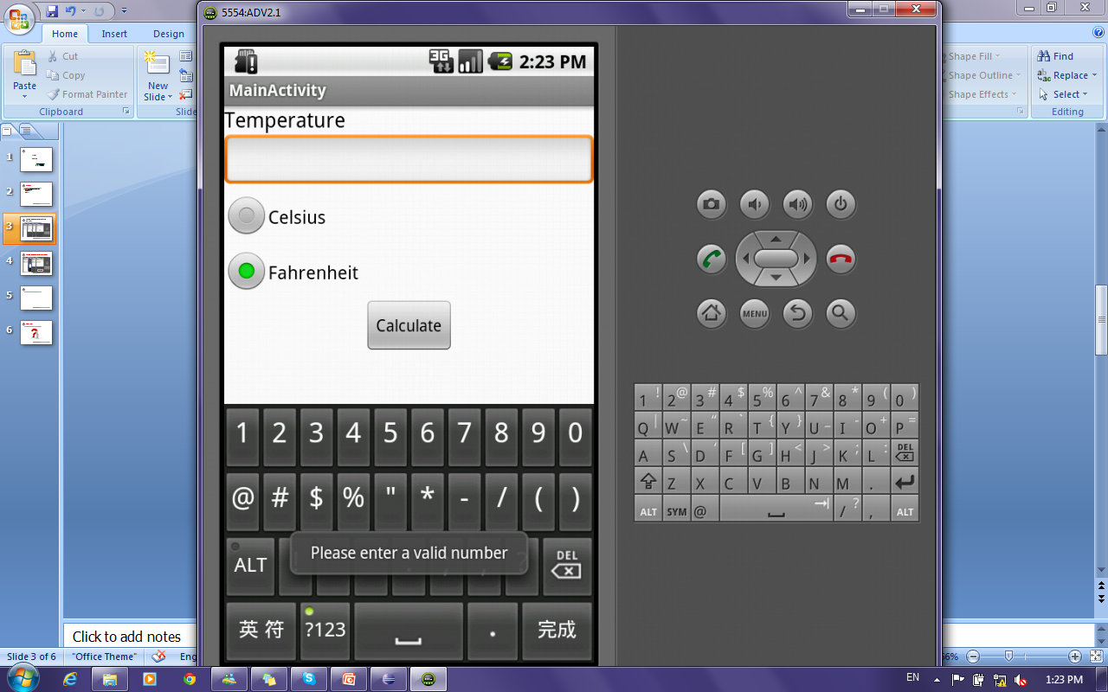
Temperature Converter Application: Radio Buttons

Slide 4
Temperature Converter Application: Toast
A toast is a view containing a quick little message for the user.
The Toast class helps you create and show required message.

Slide 5
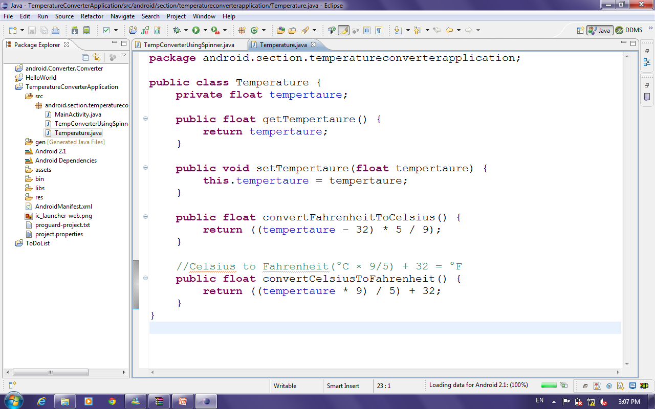
Temperature Converter Application: Radio Buttons Cont’
Temperature Class

Slide 6
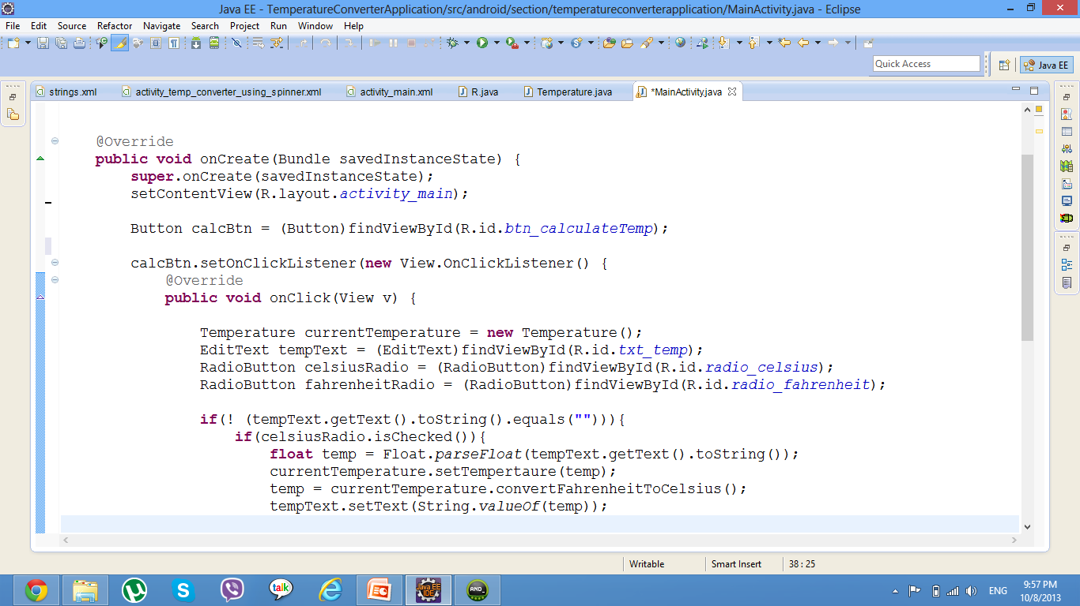
Temperature Converter Application: Radio Buttons Cont’
Get views by their ids.
Add onclick Listener to the button.
Define temperature object.

Slide 7
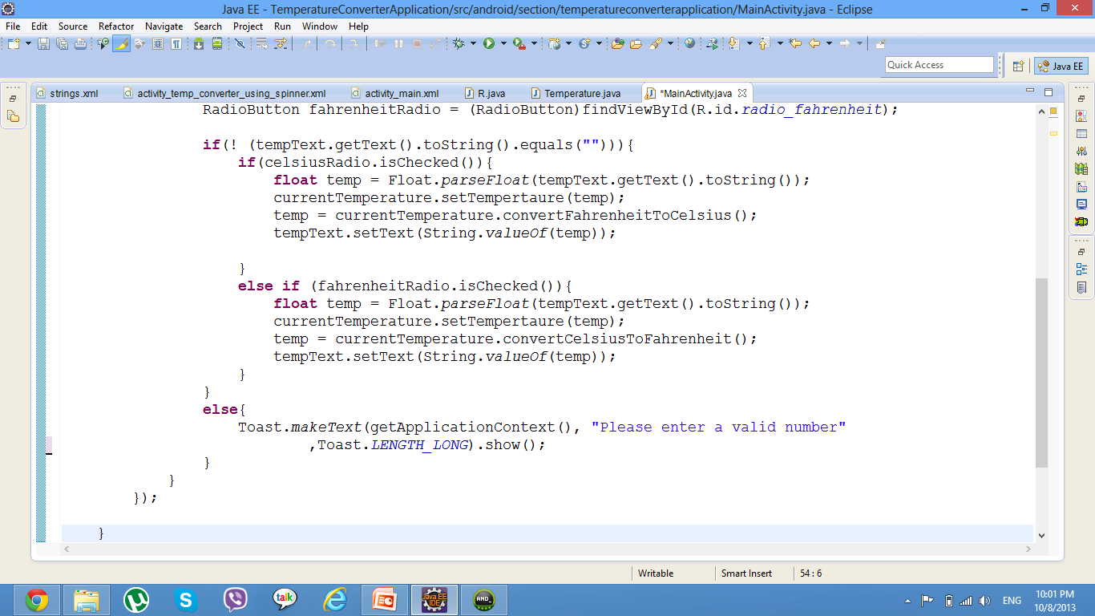
Temperature Converter Application: Radio Buttons Cont’
Converting Tempertaure
Comparing two strings using equals method
Method to check if radio button is checked
Show Msg to user with invalid input
Notes:
LENGTH_LONG Show the view or text notification for a long period of time.
LENGTH_SHORT Show the view or text notification for a short period of time.
makeText(Context context, CharSequence text, int duration) : Make a standard toast that just contains a text view.
Parameters
context: The context to use. Usually your Application or Activity object.
You can get the context by invoking Activity_name.this, getApplicationContext(), getContext(), getBaseContext()or this (when in the activity class).
It lets newly created objects understand what has been going on. Typically you call it to get information regarding another part of your program (activity, package/application). It also gives access to the resources of the project and the global information about the application environment.
For example, you can check the size of the current device display via the Context.
text: The text to show. Can be formatted text.
duration: How long to display the message. Either LENGTH_SHORT or LENGTH_LONG

Slide 8

Temperature Converter Application: Radio Buttons Cont’
30 Minutes
GUI: Update IDs and Texts of views
Implement Temperature Class
Add Functionality in .java file

Slide 9
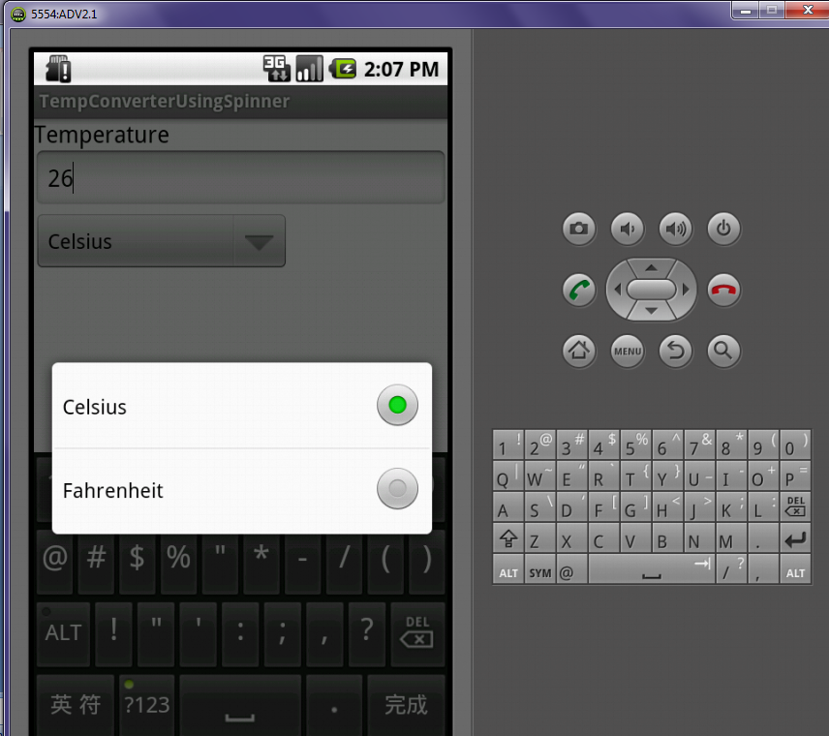
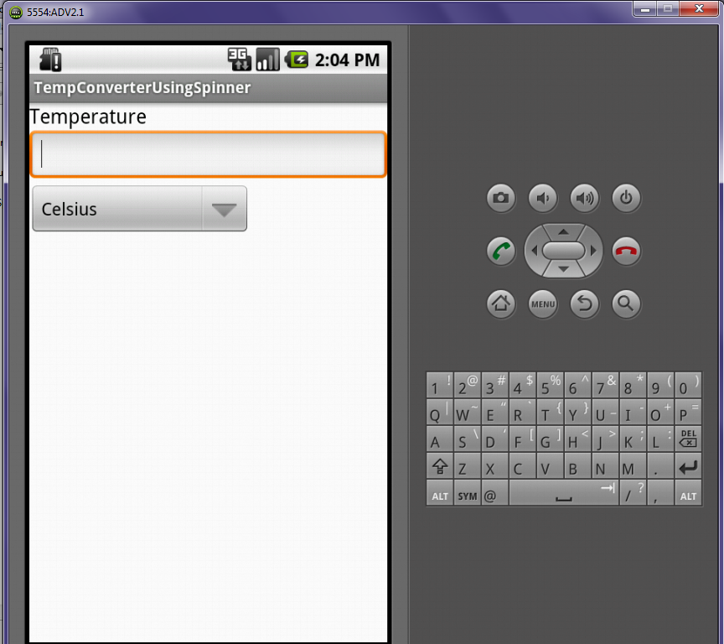
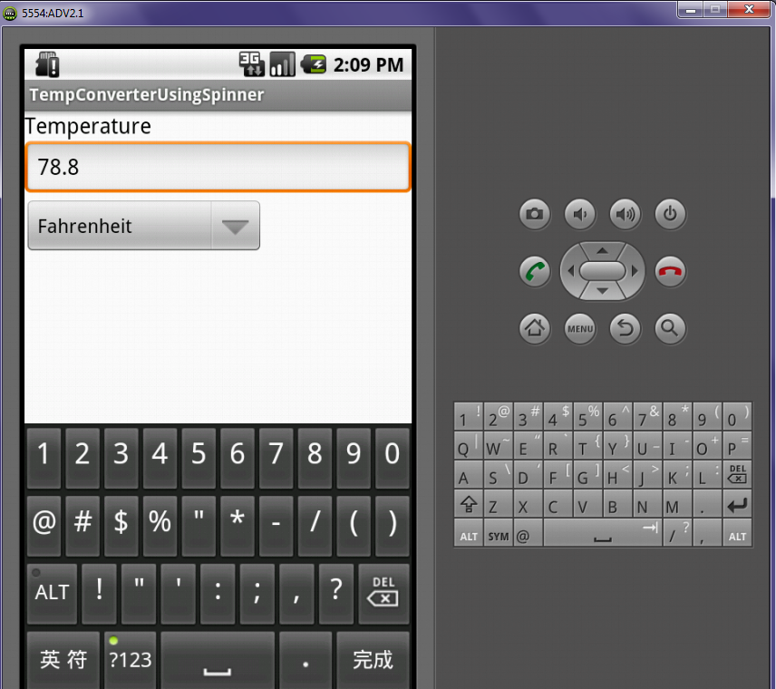
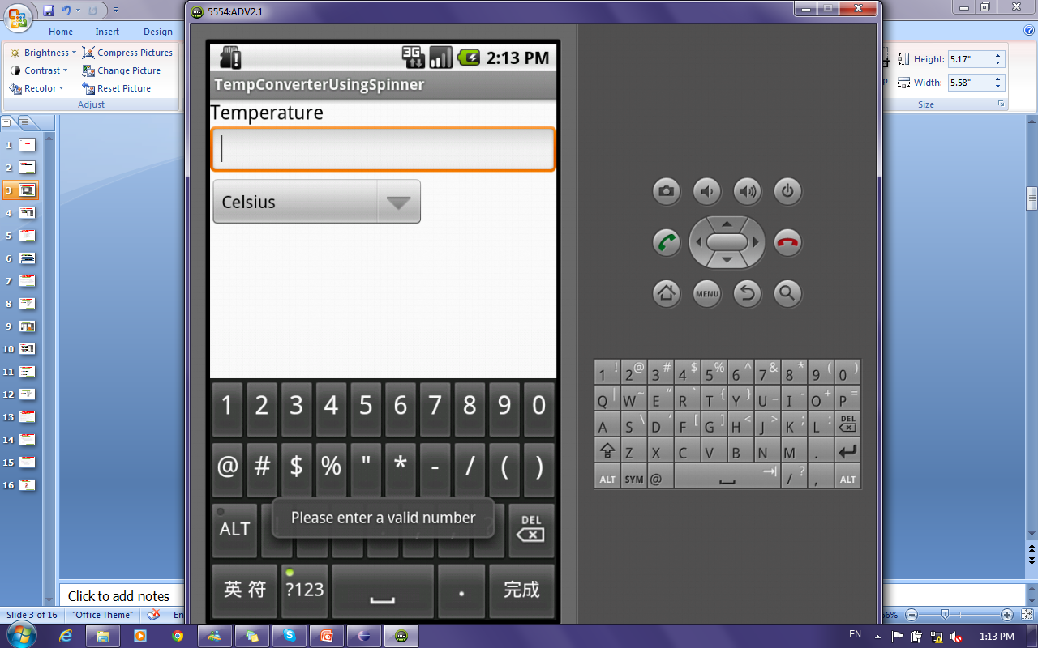
Temperature Converter Application: Spinners

Slide 10
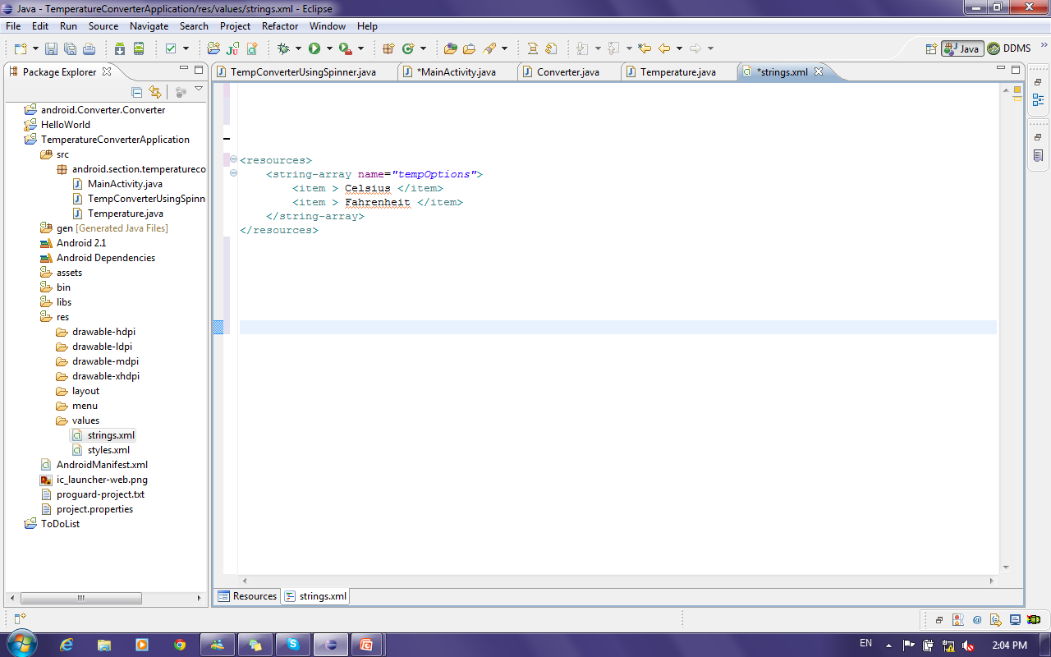
Temperature Converter Application: Spinners Cont’
How to add values in spinners ?!
By Defining an array of strings in the String file

Slide 11
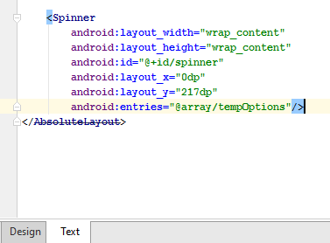
Temperature Converter Application: Spinners Cont’
How to Bind defined array to spinner ?!
Notes:
Two ways to bind array of values to a spinner
In GUI ( right click→show in→ properties→ entries→ array (then select array name to bind to ) )
In Code (Next Lab)

Slide 12
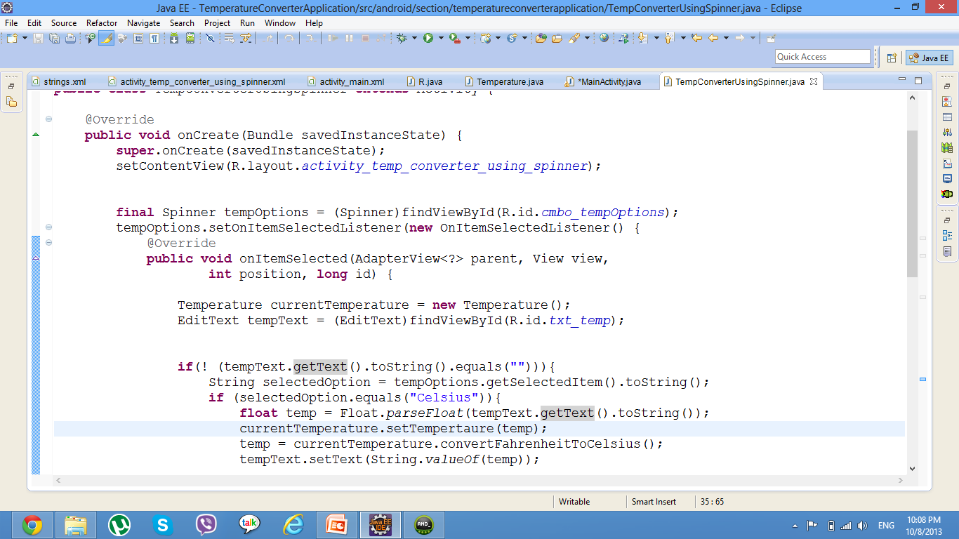
Temperature Converter Application: Spinners Cont’
Notes:
onItemSelected(AdapterView<?> parent, View view, int position, long id): Callback method to be invoked when an item in this view has been selected.
This callback is invoked only when the newly selected position is different from the previously selected position or if there was no selected item.
Impelmenters can call getItemAtPosition(position) if they need to access the data associated with the selected item.
Parameters
parent:The AdapterView where the selection happened
view: The view within the AdapterView that was clicked
position: The position of the view in the adapter
id: The row id of the item that is selected
Why using final keyword:
The variables tempOption is a local variables in the main() method. The object that you create with the anonymous class might last until after the main() method returns.
When the main() method returns, local variables (such as tempOption) will be cleaned up from the stack, so they won't exist anymore after main() returns.
But the anonymous class object references these variables. Things would go horribly wrong if the anonymous class object tries to access the variables after they have been cleaned up.
By making tempOption final, they are not really variables anymore, but constants. The compiler can then just replace the use of tempOption in the anonymous class with the values of the constants (at compile time, ofcourse), and you won't have the problem with accessing non-existent variables anymore.

Slide 13
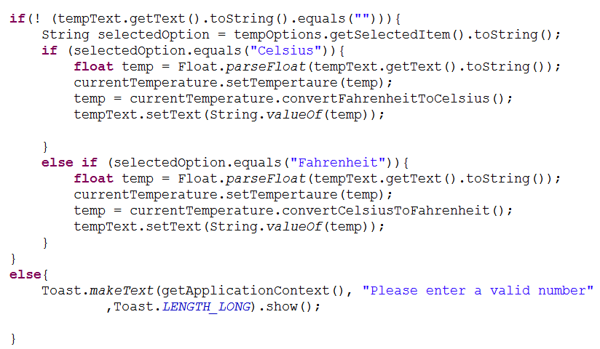
Temperature Converter Application: Spinners Cont’
Method to get selected value from spinner
Converting Temperature
Checking value of returned selected value using equal method
Show Msg to user with invalid input

Slide 14
Temperature Converter Application: Spinners Cont’
15 Minutes
Update GUI by adding spinner and
bind it to the array of strings defined
in string file.
Add Functionality in .java file.

Slide 15
Deploying Android Application to Mobile
From general settings in your mobile :
- several clicks on build number .
- then developer options will appear.
- enable USB debugging.
- when running the application your mobile will appear online to run on.
OR:
Copy the APK file to your Android’s memory card in your phone.
.apk file exists in :
app folder of your project ->build->outputs
Click and install your APK files.

Slide 16
